Slide 1
Preliminary Research and Operational Analysis
Jacob Labasi, William Labasi, Landon Jobe

Slide 2
Phase 1: System Selection and Recommendations

Slide 3
Goal and Deliverables
Goal: Decide what the digitial twin represents and research both systems (ground vs space)
Deliverables:
Trade study (ground vs space system)
Recommendation for which system
Initial system requirements

Slide 4
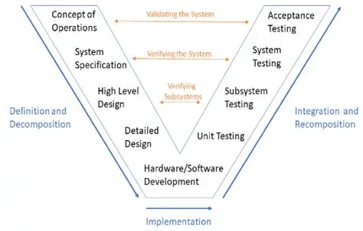
Where are we in Project Development?

Slide 5
Ground vs. Satellite

Slide 6
Comparison
Ground Station | Satellite
Somewhat easier to find information on technology, tracking methods, etc. Reliable communication, control, and access Immediate data analyzation once received Latency in communication with satellite Can only track for minutes at a time Geographical and weather limitations | Real-time data collection Maneuverable Reduced ground dependency Complexity Sensor capabilities Vulnerable to debris, radiation, and interference

Slide 7
Required Technologies

Slide 8
Ground Antenna
Ground vs Satellite Tech
Satellite
Both
Antenna & Radio Frequency (RF) Modeling
Ground Station Communications
Weather & Environmental Monitoring
Mechanical Monitoring
Orbital Mechanics & Mission Analysis
Guidance, Navigation, & Control (GNC)
Space Environment Modeling
Space Domain Awareness
Satellite Communications
Digital Twin Modeling
Data Integration
Databases
Visualization Dashboards
AI / ML
Cybersecurity

Slide 9
Initial Framework Use

Slide 10
Framework
Initial research suggests replicating a satellite-based space object tracking and communication system, as it offers better applications. The satellite option provides a stronger long-term value, greater possibilities for future applications, continuous object analysis (red vs. blue), and mobility beyond a single ground location. Although a ground antenna or telescope would be simpler, less complex, and possibly cheaper, the space system's benefits for Auria’s mission outweigh those of the ground system.
The recommended approach is a hybrid modeling satellite/tracking digital twin—combining physics-based, data-driven, and AI-assisted models—that simulates:
Satellite position and orbit behavior
Object tracking
Communications (link quality, speed, resilience, etc.)
Environmental effects
Friendly vs. Unknown/debris/threat idenfification
Basic cyber and mission scenario testing
Satellite health and subsytem monitoring
Collision avoidance and conjunction analysis
Mission readiness and operational analysis

Slide 11
Major Satellite Subsystems

Slide 12
Major Satellite Subsystems
Electronics and Avionics
Command and Data Handling (C&DH), onboard software
GNC
Attitude and Orbit Control System (AOCS), sensors, actuators, propulsion subsystem
Communication
Telemetry, Tracking, and Control (TT&C), antennas, transponders and receivers
Power
Power Control System, solar arrays, batteries
Propulsion
Chemical, electrical, cold gas
Thermal
Heat pipes, heaters, radiators, multi-layer insulation
Payload
Mission-dependent

Slide 13
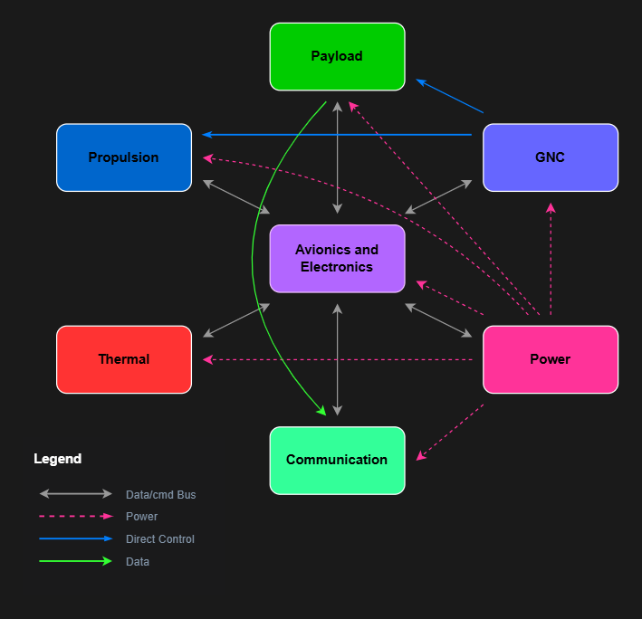
Subsystem Interaction

Slide 14
Space Domain Awareness (SDA) and Rendezvous & Proximity Operation (RPO)

Slide 15
SDA and RPO
Space Domain Awareness
Addresses satellite detection, tracking, characterization, threat warning and assessment, data integration, and identification of unknown objects.
AI support through:
Catalogue maintenance and uncorrelated tasks
Orbit determination
Collision assessment
Sensor tasking, scheduling, and prioritization
Data Collection and Integration
Rendezvous and Proximity Operation
Describes maneuvering against other satellites, is highly complex and time consuming
AI Enhancement: Orbital Warfare
Object and movement detection
Autonomous GNC
Data filtering and prioritization
Autonomous Bus subsystem management
Dynamic communications management

Slide 16
Inputs and Outputs

Slide 17
Satellite Inputs and Outputs
Inputs
Satellite telemetry: sensor data
Orbital state vectors: position vectors
Space surveillance tracking data: tracking data
Environmental conditions: pre-launch, post-launch
Mission objectives: assigned parameters
Command history: documented history
Outputs
Predicted orbital positions: position
Collision risk assessments: proximity events
Data Models and Outliers: data training
Event detection/simulation: simulated events
Health status: system efficiency
Operator recommendations: subject to operator

Slide 18
Preliminary Requirements Stage

Slide 20
Beginning of Phase 2: Operational Analysis (TBD)

Slide 21
Goal and Deliverables
Goal: Map out the real system
Deliverables:
Data flow diagram
System architecture diagram
Functional decomposition diagram
Data architetcure/reference diagram

Slide 22
Data Architecture

Slide 23
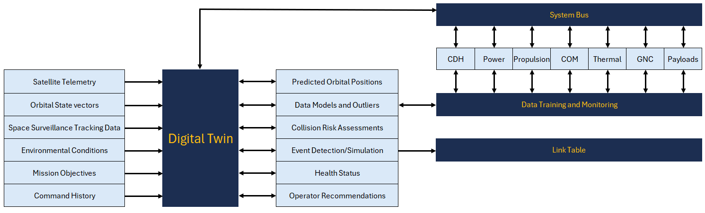
Initial Data Architecture Diagram

Slide 24
Functional Decomposition

Slide 25
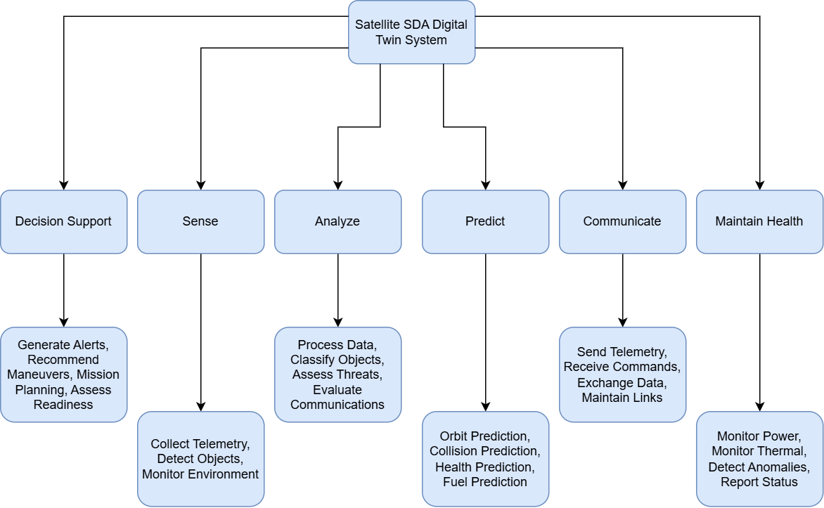
Initial Functional Decomposition Diagram

Slide 26
System Architecture

Slide 27
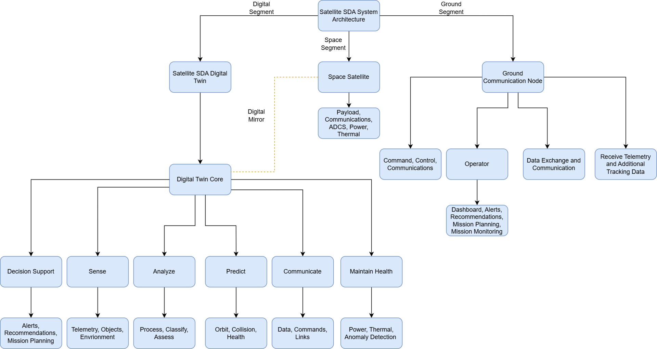
Initial System Architecture Diagram

Slide 28
Upcoming Plans

Slide 29
The Future…
Get final approval of framework requirements and satellite-specific requirements
Create data flow diagram based on requirements
Begin rough draft of digital twin framework
Potential: Published white paper on digital twin implementation for end-of-term deliverable
Certification opportunities

Slide 30
If Dave was a plane?...

Slide 31
